Slide 1
COS 212 Binary Trees: Deletion

Slide 2
Deleting a node from BST
How do we delete nodes?
Deleting a leaf is easy:
5
5
3
7
3
7
1
4
6
9
1
6
9

Slide 3
Deleting a node from BST
How do we delete nodes?
Deleting a node with a single child is easy, too:
5
5
3
7
1
7
1
6
9
6
9

Slide 4

Deleting a node from BST
How do we delete nodes?
Deleting a node with two children is less obvious:
3
3
1
8
1
6
10
6
10
5
7
5
7

Slide 5
Delete by merging
Property of BST:
all sub-nodes to the left of n will be < n
all sub-nodes to the right of n will be > n
If we take the largest node on the left of n, it will be:
> than all other nodes in the left sub-tree of n
< than all the nodes in the right sub-tree of n
It will always be the rightmost node of n’s left branch
3
1
8
6
10
5
7

Slide 6
Delete by merging
Start from the root
Find the node to be deleted using a search, call it n
Find the rightmost node in the left subtree of n, call it m (traverse left from n, then right until you find a NULL)
The right subtree of n becomes the right subtree of m
The left child of n takes n’s place
3
3
1
8
1
6
6
10
5
7
5
7
10

Slide 7
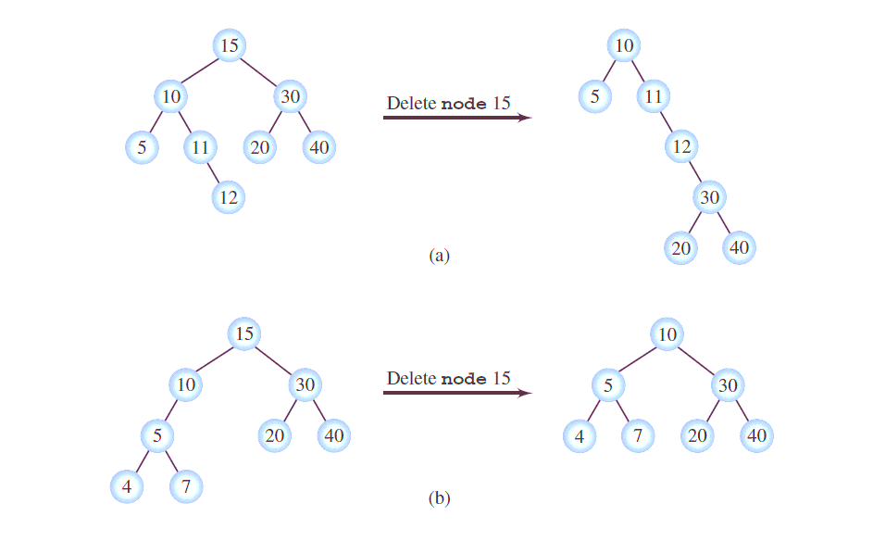
Delete by merging: Tree Height
Disadvantage?
Advantage?

Slide 8
Delete by Copying
Delete by merging may change the height of the tree and make it inefficient
Is there a better way?
If we take the largest node on the left of n, it will be:
> than all other nodes in the left sub-tree of n
< than all the nodes in the right sub-tree of n
It will always be the rightmost node of n’s left branch
Thus, it is a perfect candidate to replace the deleted node!
Instead of moving around subtrees, we could just take the rightmost node of the left subtree, and replace n with it

Slide 9
Delete by Copying
3
3
1
8
1
7
6
10
6
10
5
7
5
But what if the rightmost node has children?
It’s rightmost, so there is no right child
If there is a left child, it simply becomes the right child of the rightmost node’s original parent.

Slide 10
Delete by Copying
20
20
15
20
10
30
10
27
10
27
15
25
35
15
25
35
15
25
35
23
27
27
23
26
27
23
26
26
26
delete 30
delete 20

